Slide 1

Algorithms and Data Structures 2 CS 1501
Fall 2021
Sherif Khattab
ksm73@pitt.edu
(Slides are adapted from Dr. Ramirez’s and Dr. Farnan’s CS1501 slides.)

Slide 2
Announcements
Upcoming deadlines:
11/19: Lab 9 and Homework 10
11/17: Assignment 3
12/20: Assignment 4 and 5

Slide 3
Previous lecture …
Computing shortest paths on graphs with edge weights
Dijkstra’s Single-Source Shortest Paths Algorithm
Kruskal’s MST Algorithm

Slide 4
CourseMIRROR Reflections

Slide 5
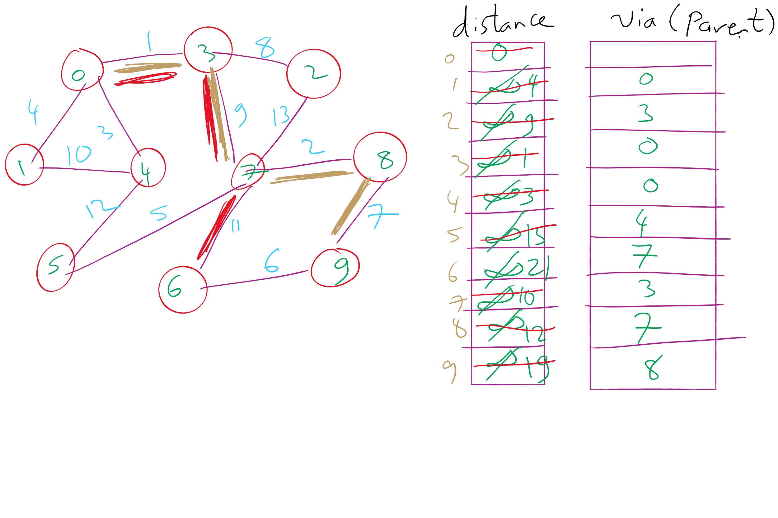
Dijkstra’s Shortest Paths Example 1

Slide 6
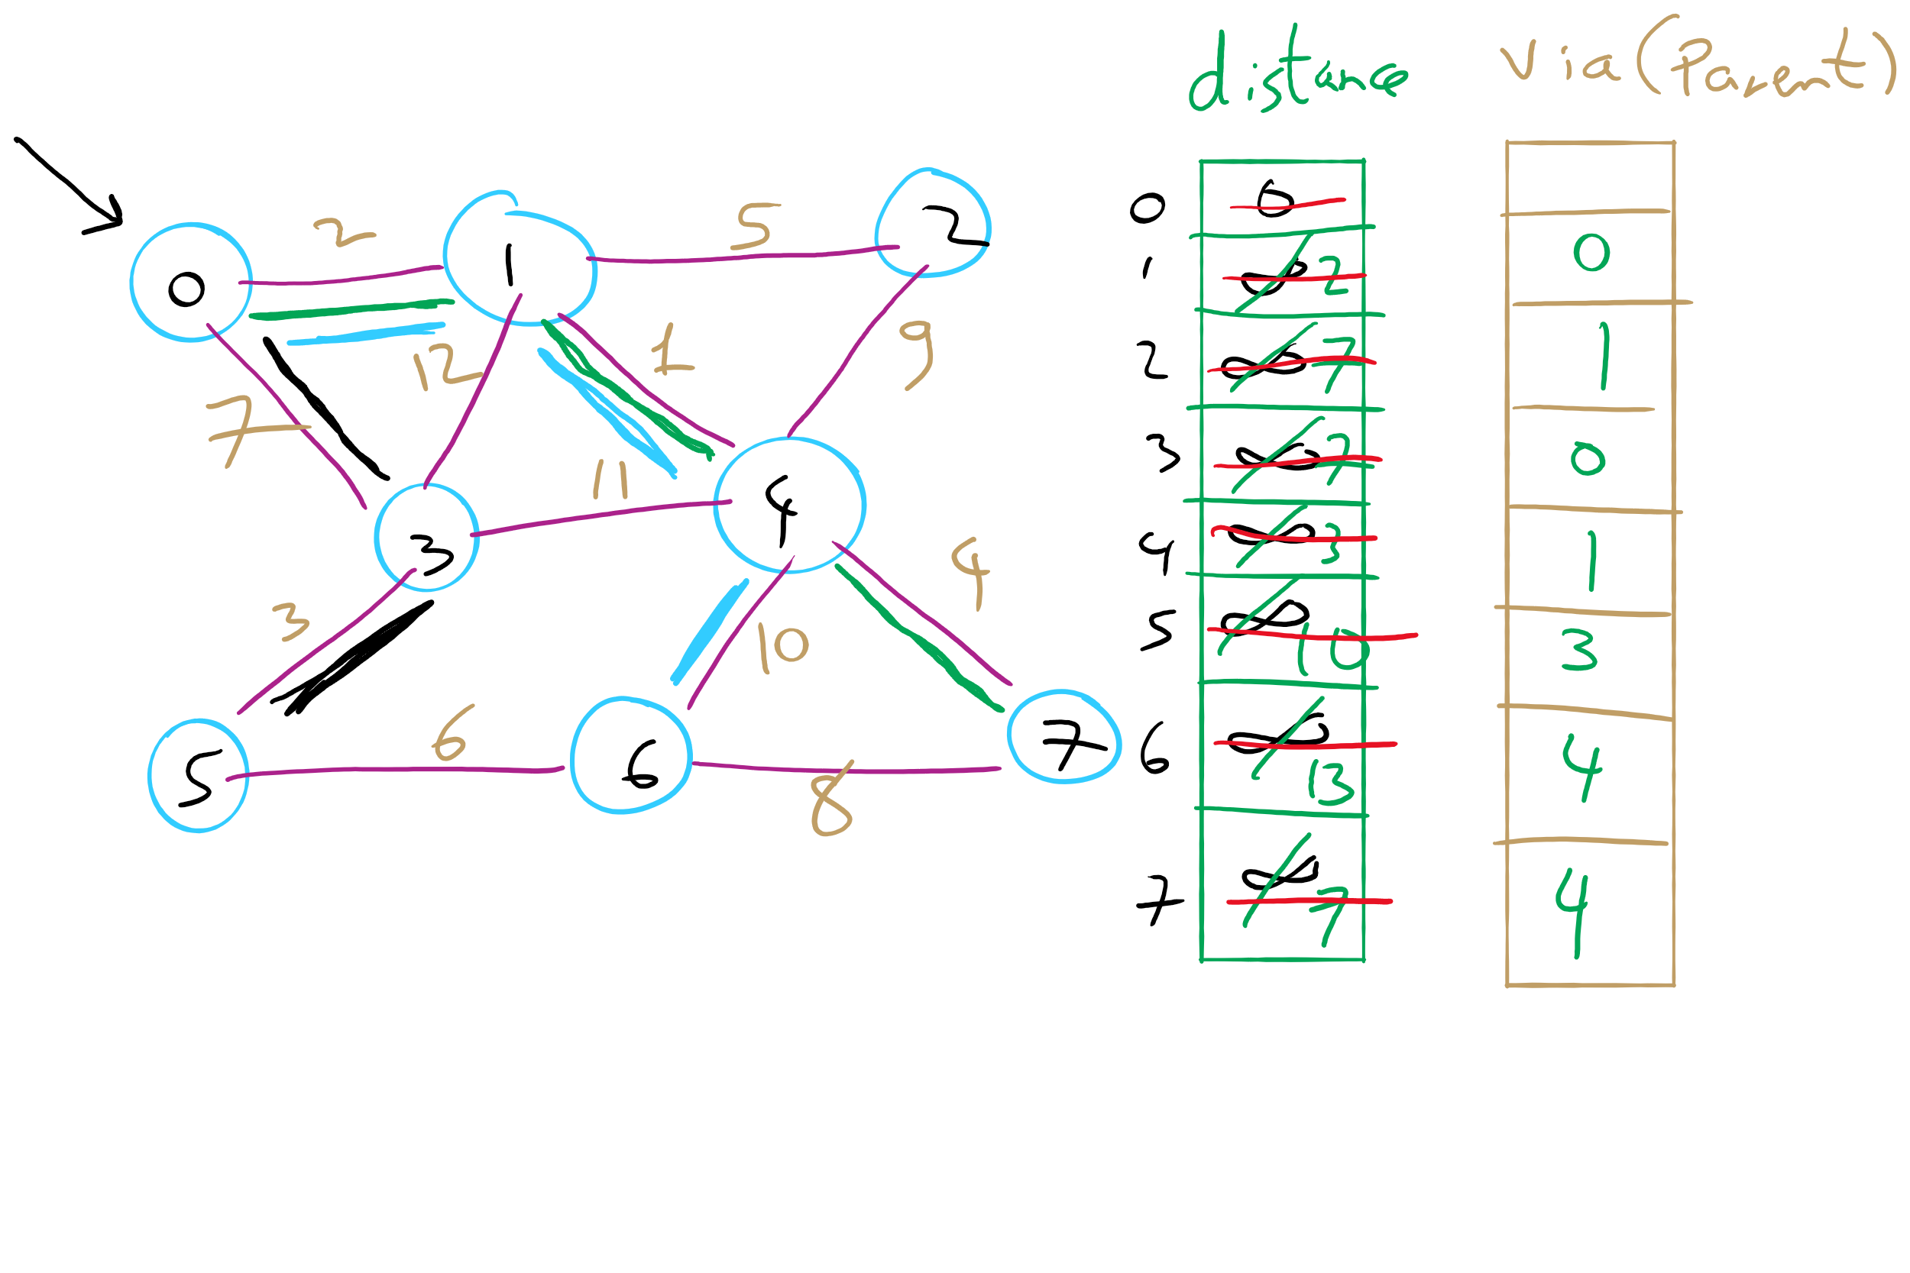
Dijkstra’s Shortest Paths Example 2

Slide 7
Today …
Union-Find Data Structure
Kruskal’s run-time with Union-Find DS
Ford-Fulkerson Maximum Flow “Algorithm”

Slide 8
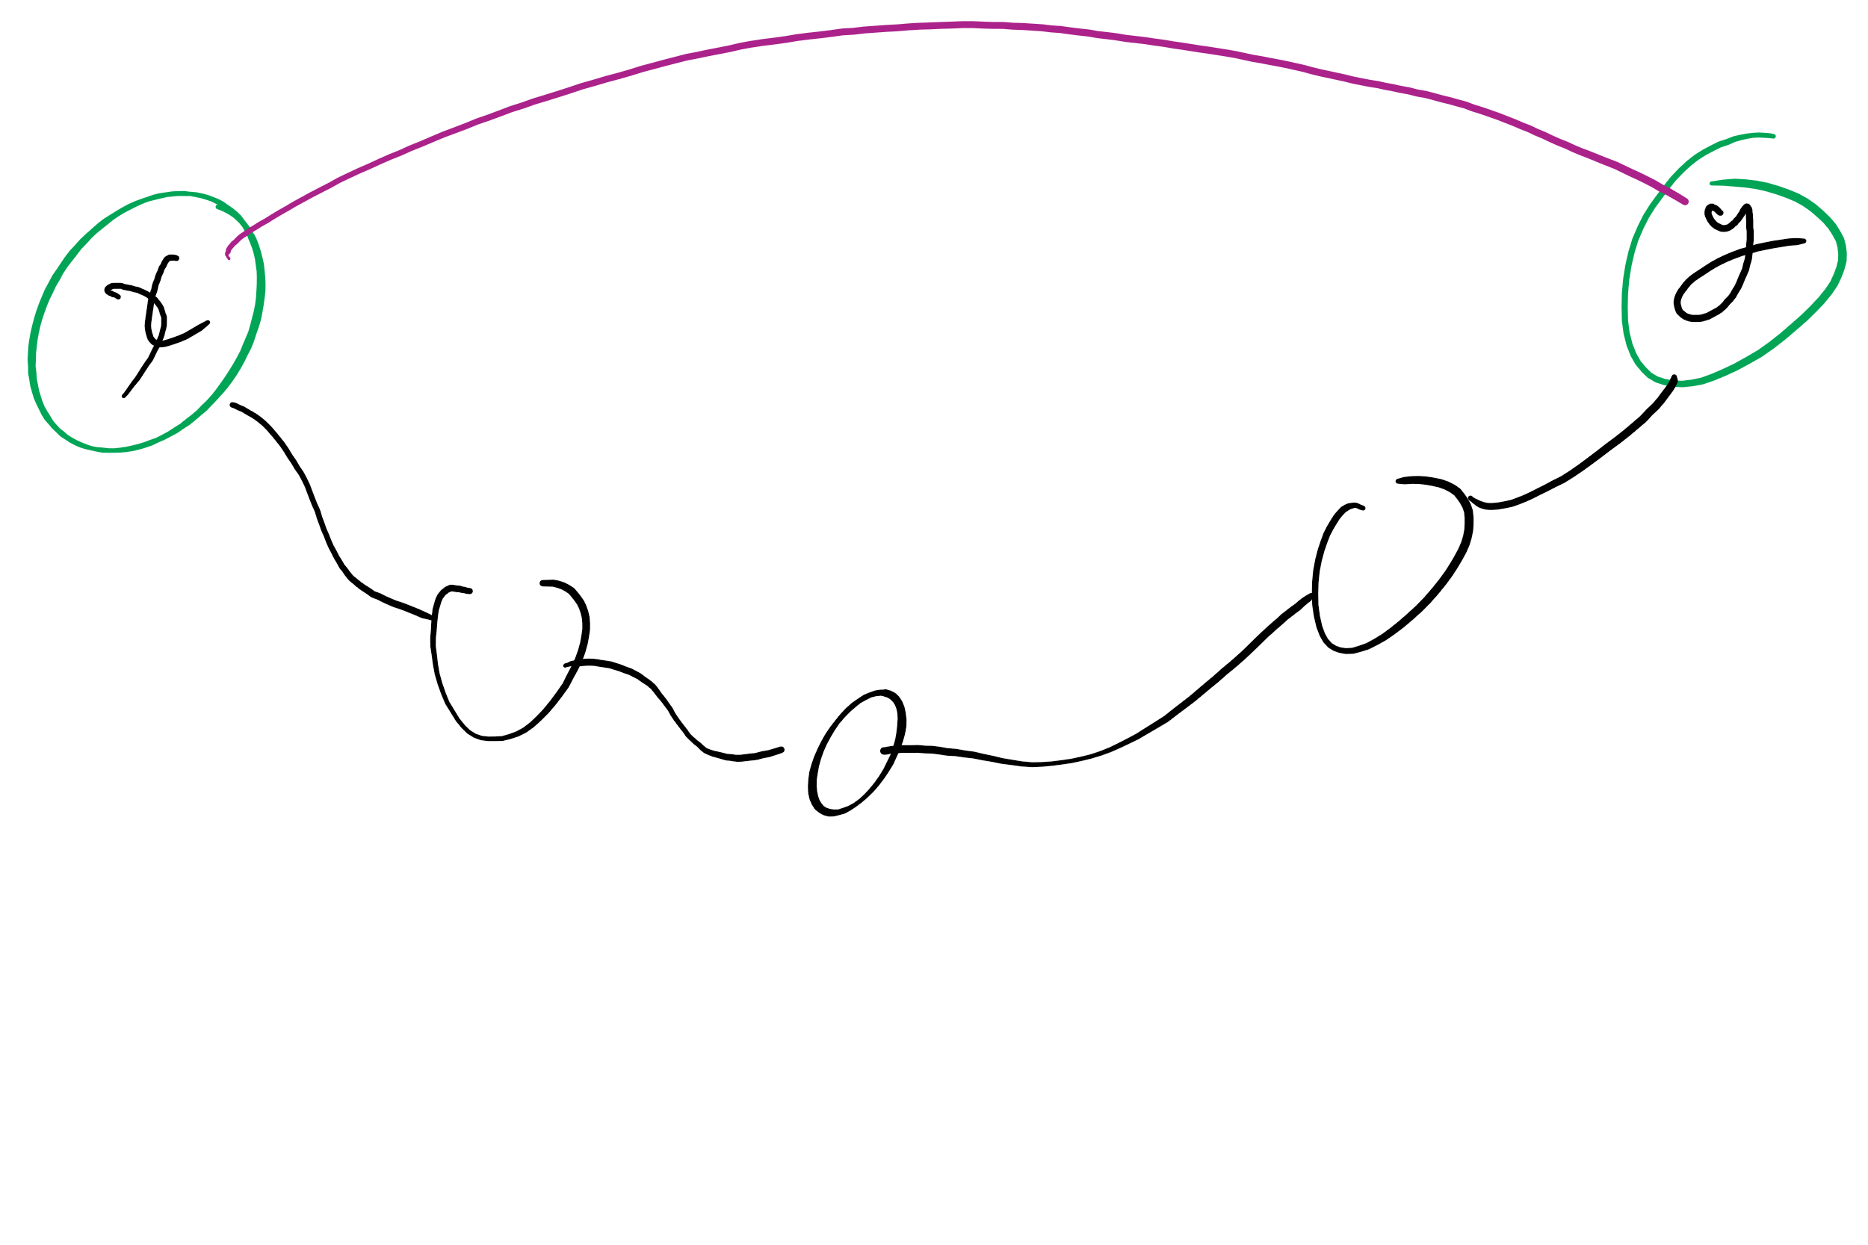
Dynamic connectivity problem
For a given graph G, can we determine whether or not two vertices are connected in G?
Can also be viewed as checking subset membership
Important for many practical applications
We will solve this problem using a union/find data structure
Notes:
after describing the problem (bullet 1), ask for a solution
Work towards getting BFS approach
Runtime?
θ(e) using adj list
How can we do better? UF

Slide 9
A simple approach
Have an id array simply store the component id for each item in the union/find structure
How do we determine if two vertices are connected?
How do we establish the connected components?
Add graph edges one at a time to UF data structure using union operations
Notes:
Ask for connected component def

Slide 10
Example
U(2, 0)
1
4
U(7, 4)
U(2, 1)
0
2
5
7
U(2, 3)
U(5, 4)
U(5, 7)
3
6
U(3, 6)
0
1
2
3
4
5
6
7
ID:
0
6
3
1
1
6
3
2
0
6
3
1
3
6
4
5
4
6
7
4
Notes:
mention how this can be view as subset membership

Slide 11
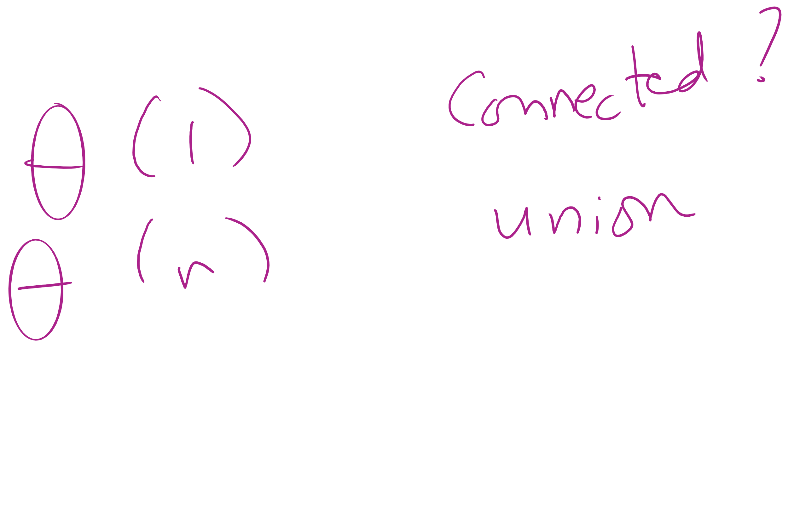
Analysis of our simple approach
Runtime?
To find if two vertices are connected?
For a union operation?
Notes:
"fast find" approach
find:
Θ(1)
union:
Θ(n)

Slide 12
Union Find API
Initialize with n items numbered 0 to n-1
UF (int n)
void union(int p, int q)
int find (int p)
boolean connected (int p, int q)
int count()
Connect p with q
Return id of the connected component that p is in
True if p and q are connected
Number of connected components

Slide 13
Covering the basics
public int count() {
return count;
}
public boolean connected(int p, int q) {
return find(p) == find(q);
}

Slide 14
Implementing the Fast-Find approach
public UF(int n) {
count = n;
id = new int[n];
for (int i = 0; i < n; i++) { id[i] = i; }
}
public int find(int p) { return id[p]; }
public void union(int p, int q) {
int pID = find(p), qID = find(q);
if (pID == qID) return;
for(int i = 0; i < id.length; i++)
if (id[i] == pID) id[i] = qID;
count--;
}

Slide 15
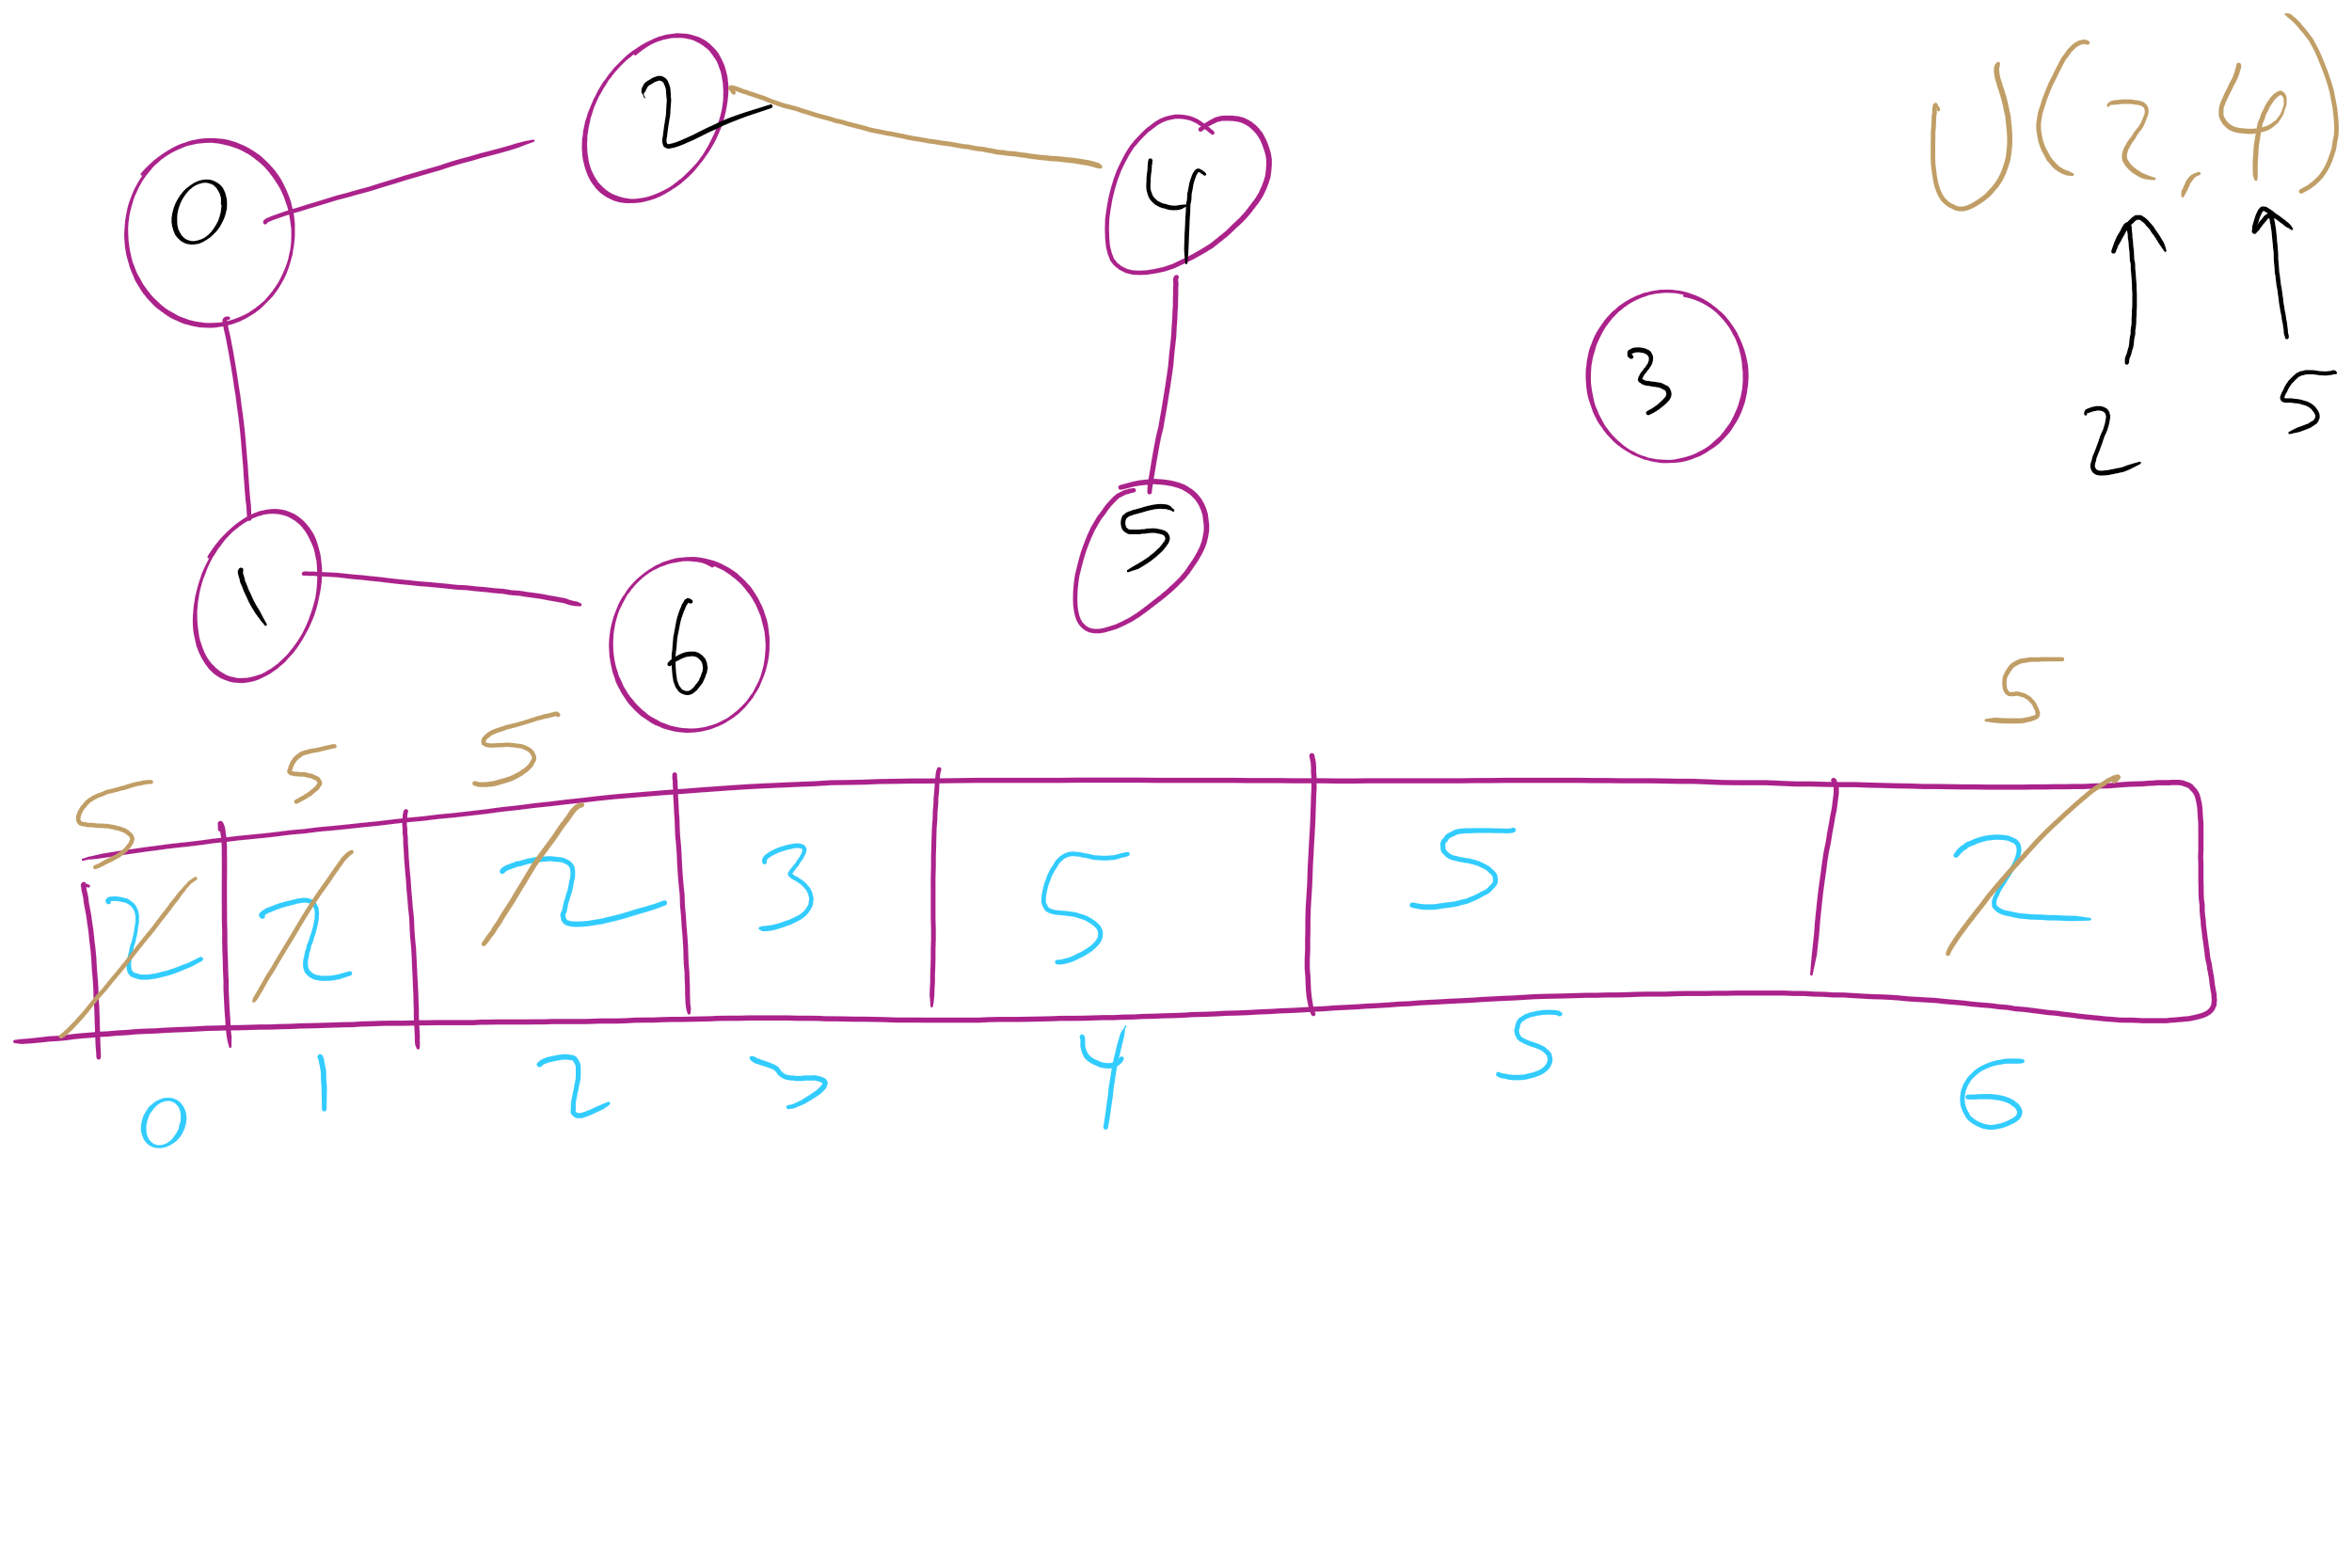
Union-Find Example 1

Slide 16
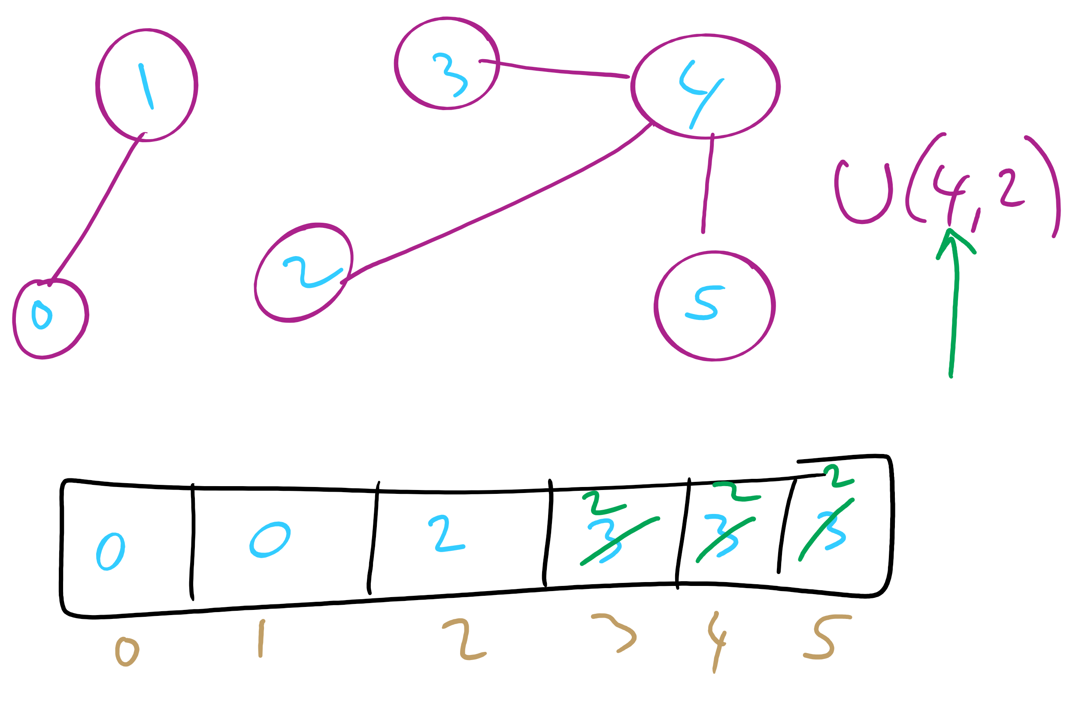
Union-Find Example 2

Slide 17
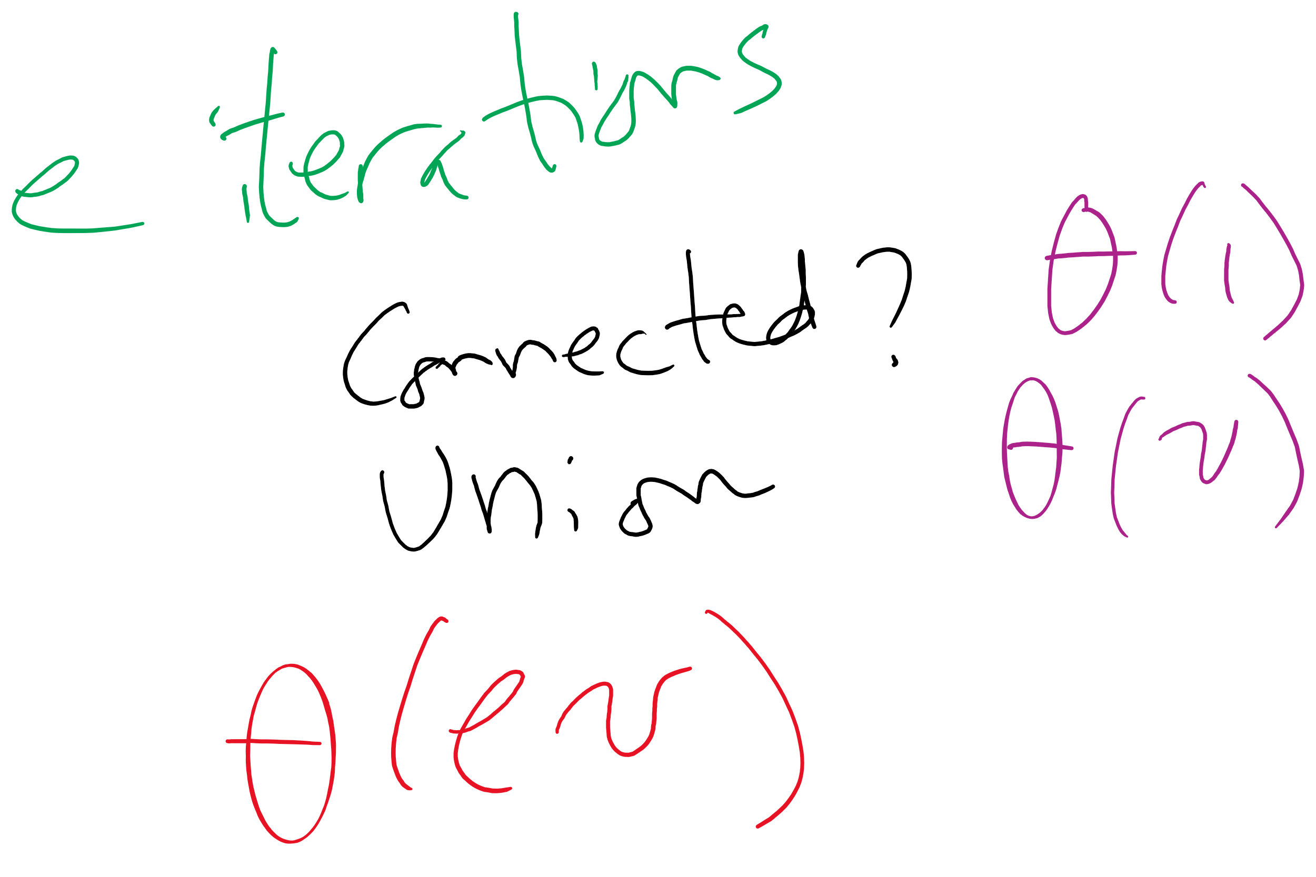
Kruskal’s algorithm Runtime: Take 2
With this knowledge of union/find, how, exactly can it be used as a part of Kruskal’s algorithm?
What is the runtime of Kruskal’s algorithm?
Notes:
Fast-Find's θ(v) union will lead to a θ(v²) runtime for Kruskal's
Each time an edge is added to the MST, need to union, hence v θ(v) union operations
These v union operations dominate runtime

Slide 18
Can we improve on union()’s runtime?
What if we store our connected components as a forest of trees?
Each tree representing a different connected component
Every time a new connection is made, we simply make one tree the child of another

Slide 19
Tree example
1
4
3
0
2
5
7
1
3
6
2
7
0
1
2
3
4
5
6
7

Slide 20
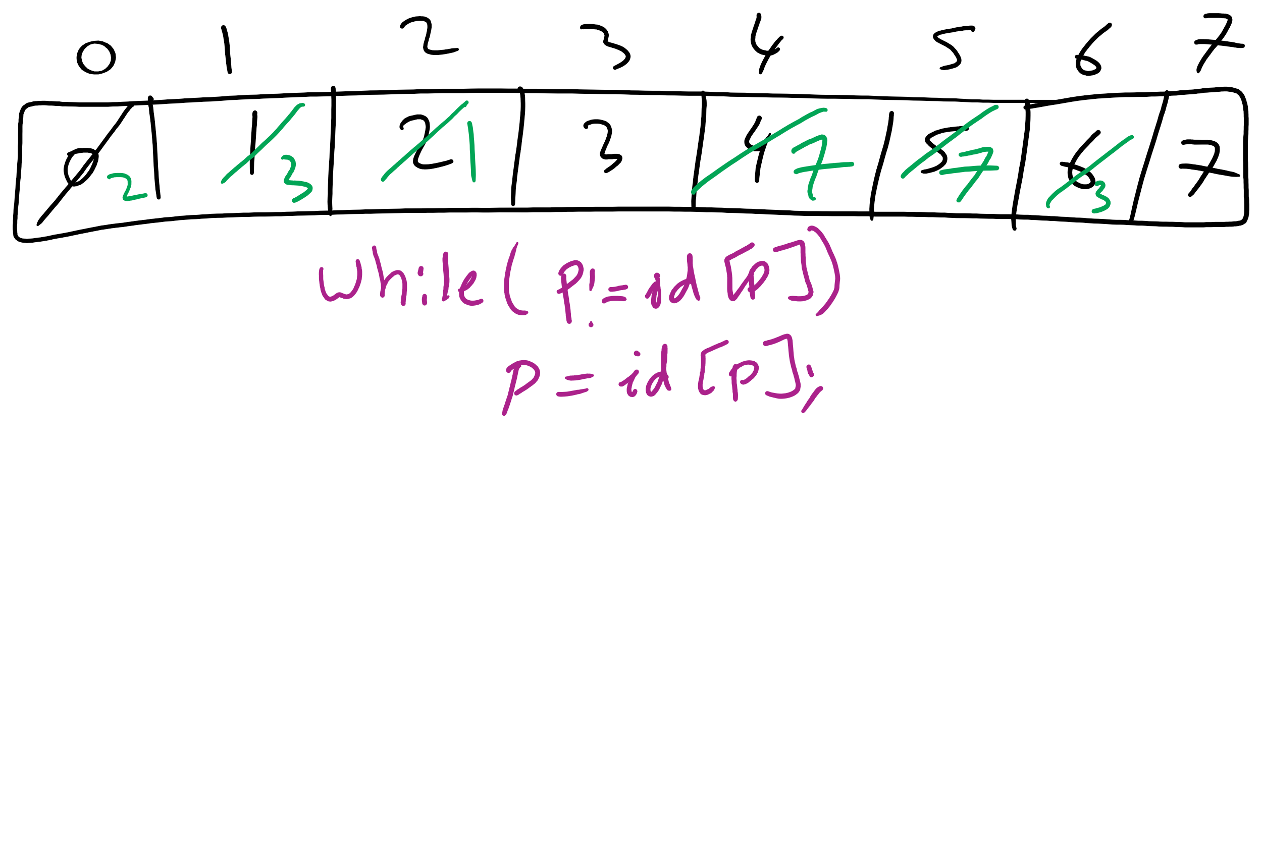
Forest of Trees Implementation
1
4
3
0
2
5
7
1
3
6
2
7
0
1
2
3
4
5
6
7

Slide 21
Implementation using the same id array
public int find(int p) {
while (p != id[p]) p = id[p];
return p;
}
public void union(int p, int q) {
int i = find(p);
int j = find(q);
if (i == j) return;
id[i] = j;
count--;
}

Slide 22
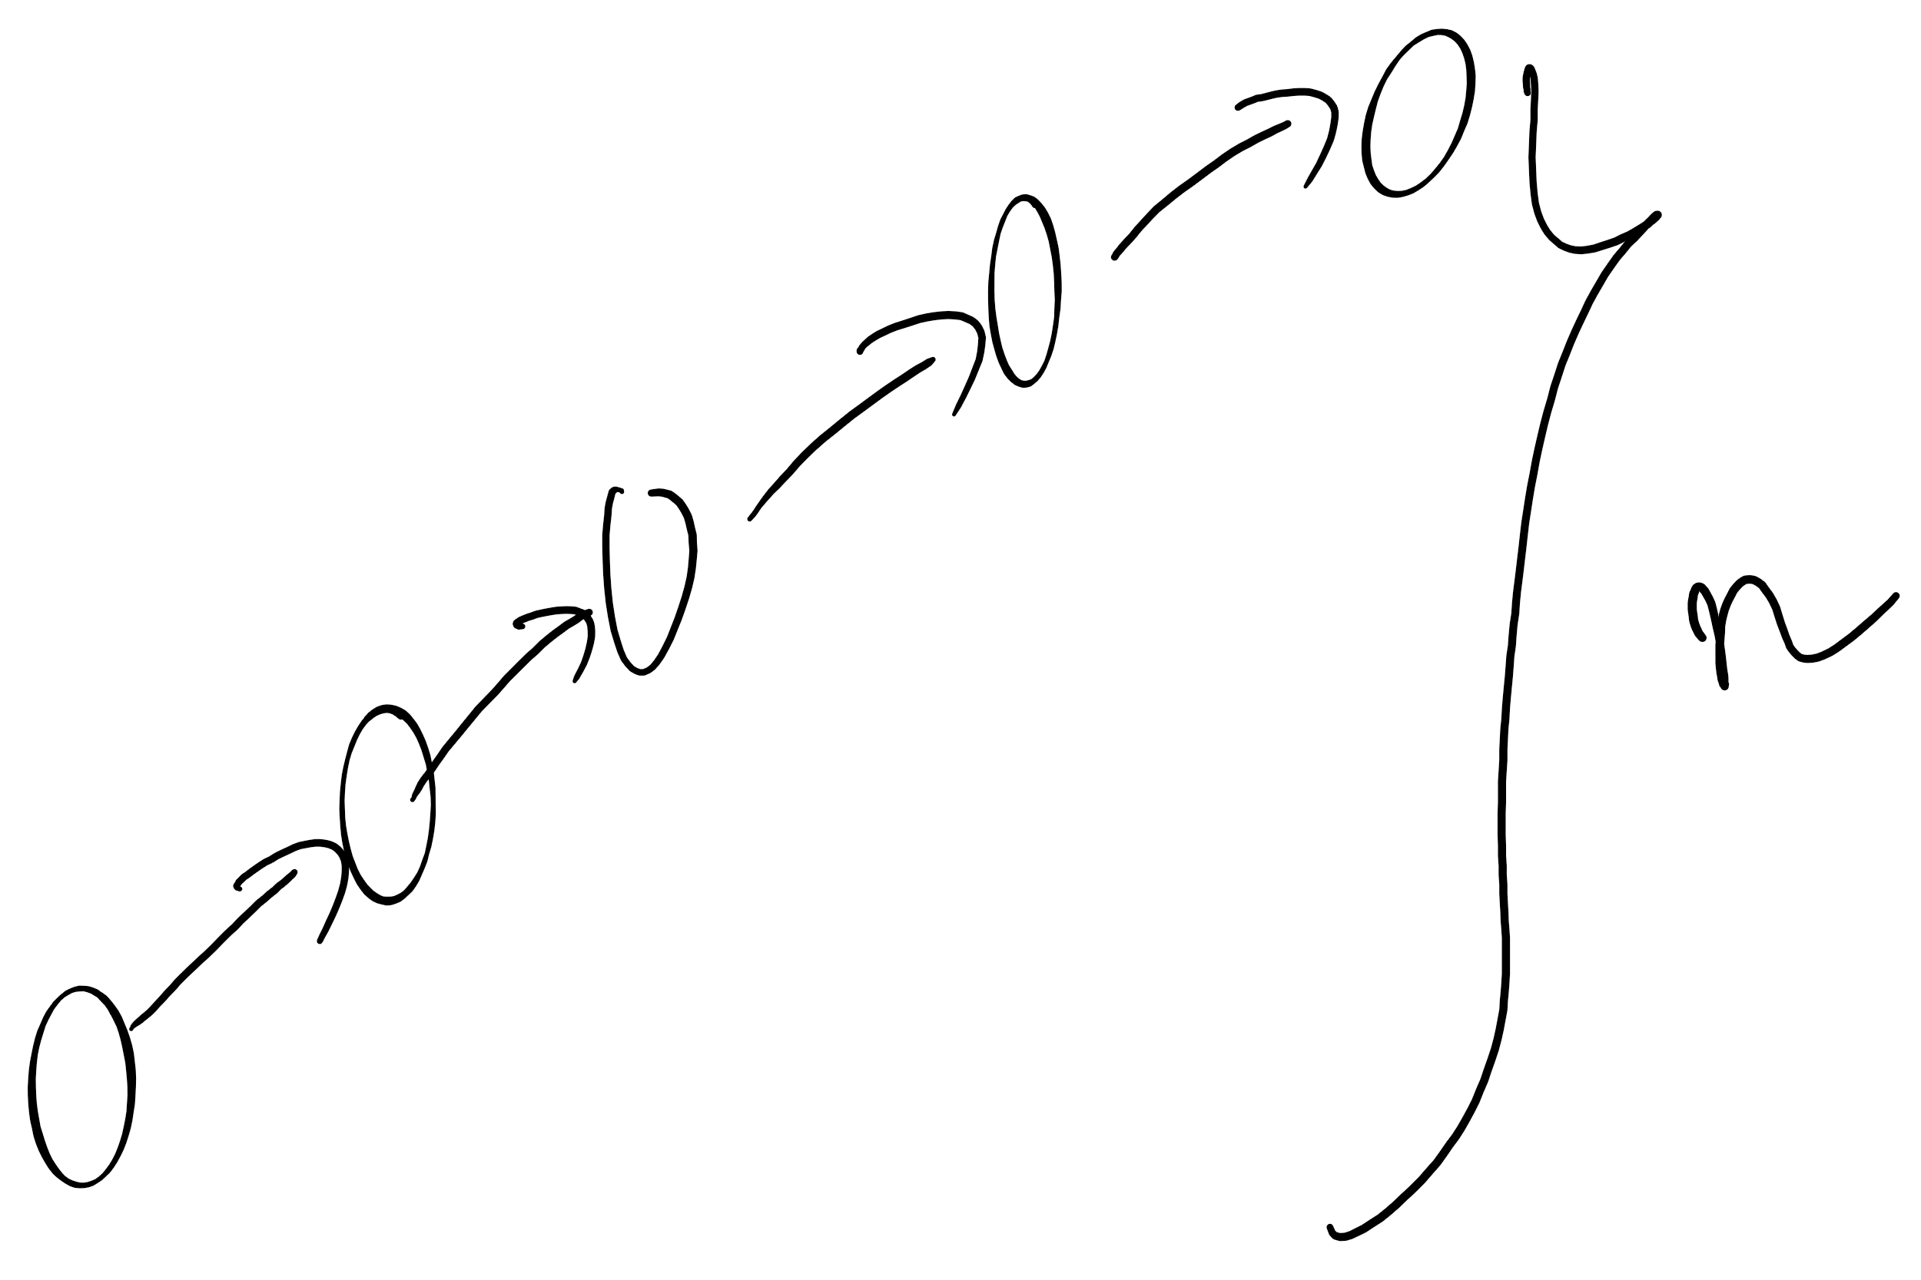
Forest of trees implementation analysis
Runtime?
find():
Bound by the height of the tree
union():
Bound by the height of the tree
What is the max height of the tree?
Can we modify our approach to cap its max height?

Slide 23
Weighted tree example
1
4
0
2
5
7
3
6
2
7
0
1
2
3
4
5
6
7

Slide 24
Weighted trees
public UF(int n) {
count = n;
id = new int[n];
sz = new int[n];
for (int i = 0; i < n; i++) { id[i] = i; sz[i] = 1; }
}
public void union(int p, int q) {
int i = find(p), j = find(q);
if (i == j) return;
if (sz[i] < sz[j]) { id[i] = j; sz[j] += sz[i]; }
else { id[j] = i; sz[i] += sz[j]; }
count--;
}

Slide 25
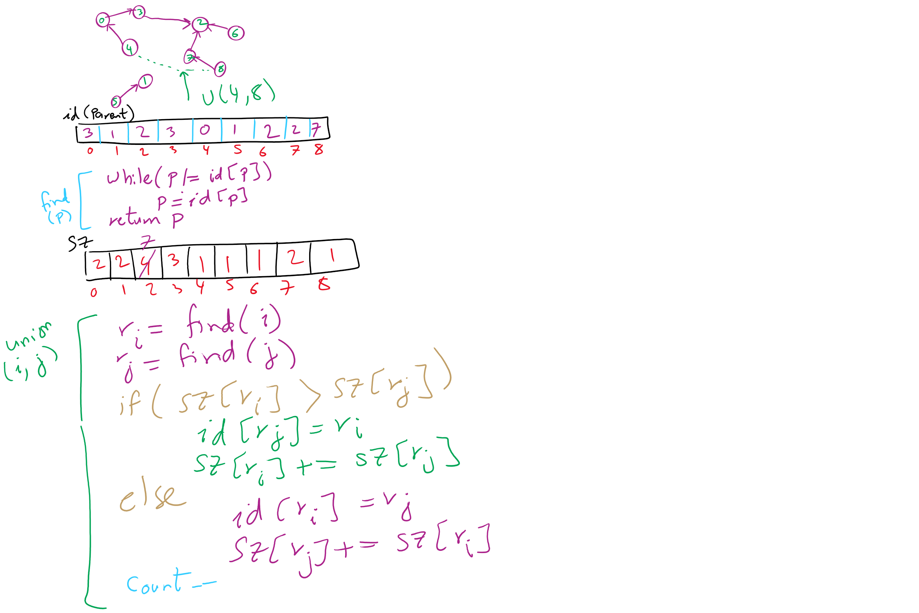
Weighted Trees Union-Find Example

Slide 26
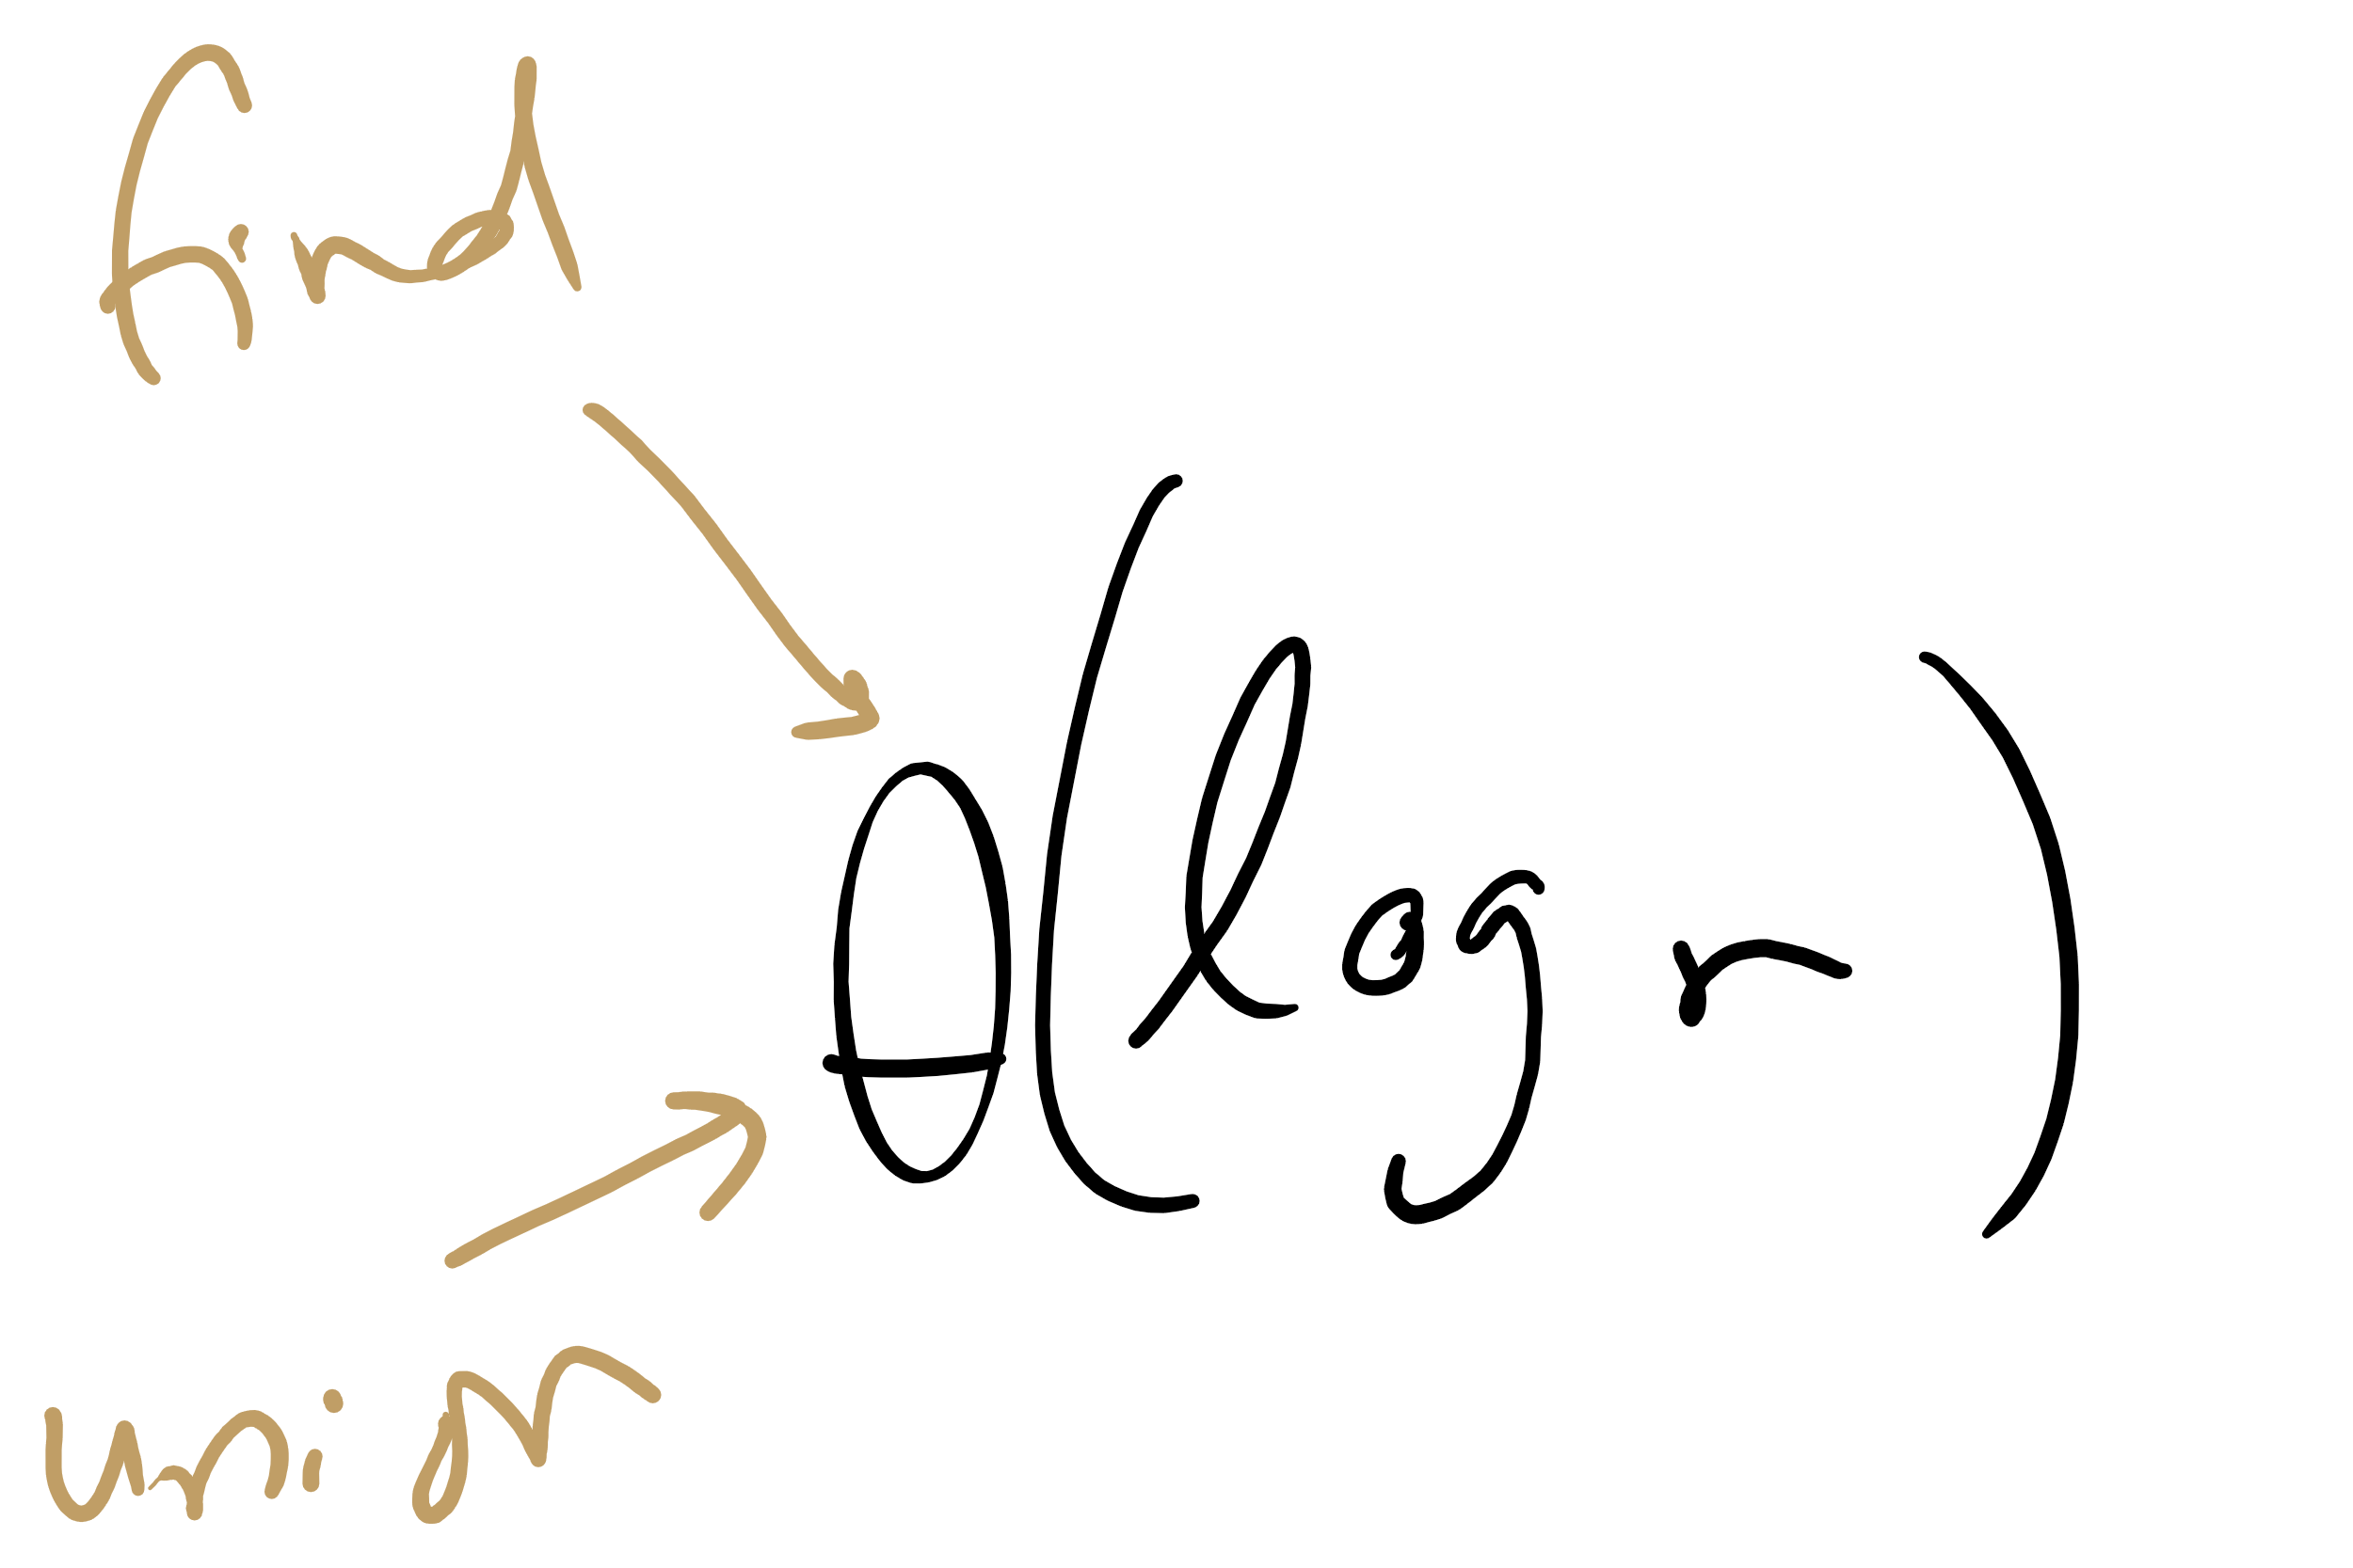
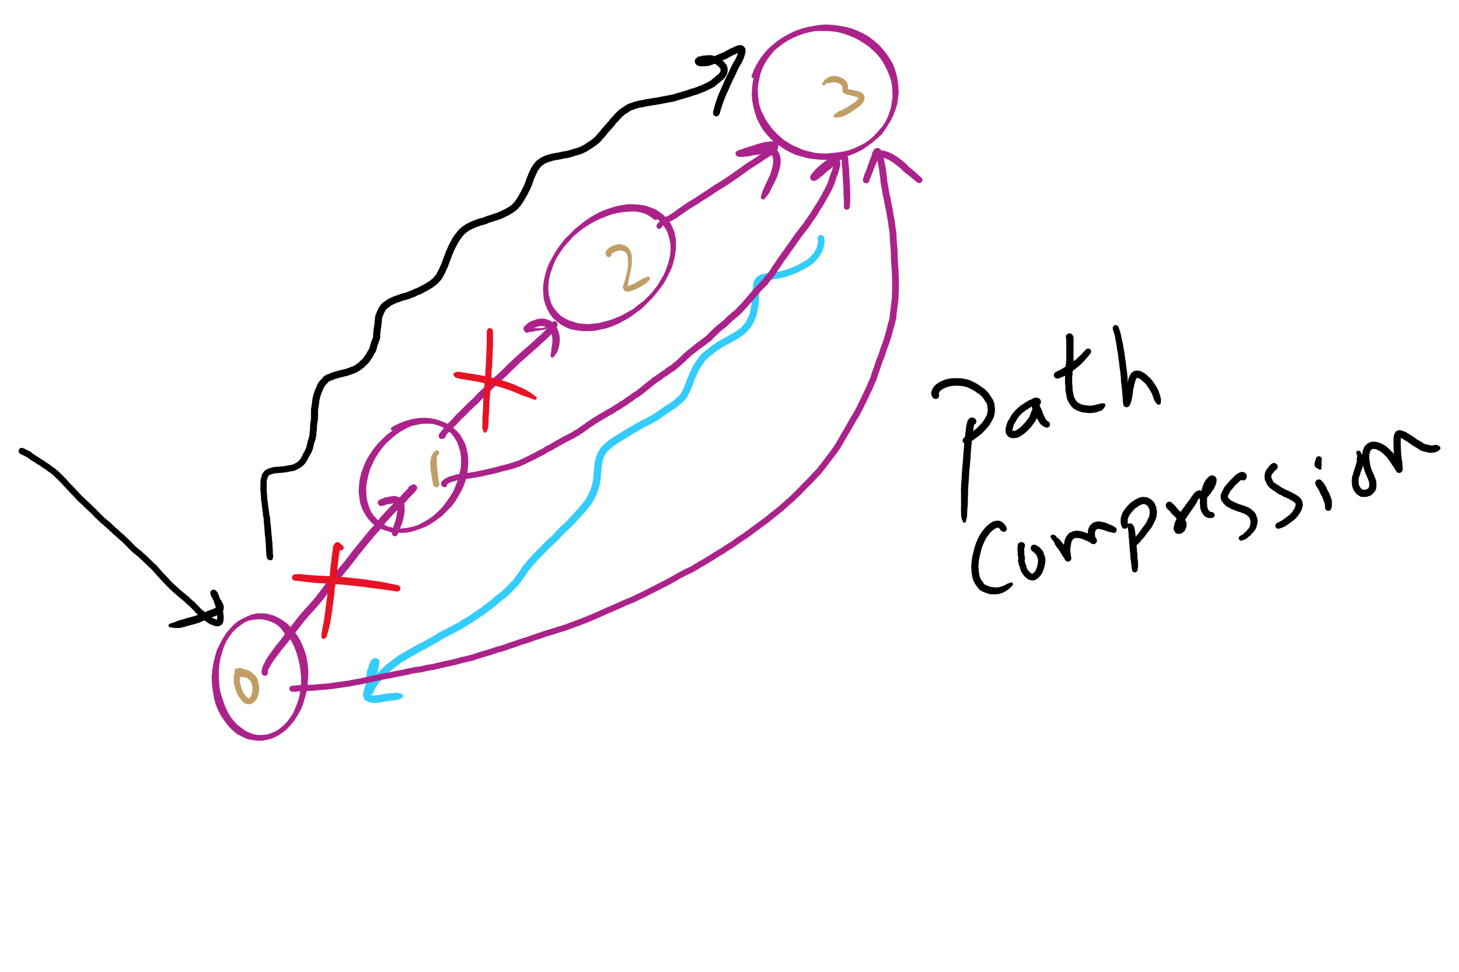
Weighted tree approach analysis
Runtime?
find()?
union()?
Can we do any better?
Notes:
Both find and union:
Θ(log v)
Trees were so flat in this example, why log v?
Because we didn't build up independent connected components
Can do better with path compression, where another loop is added to find() to link everything we come across directly back to the root
this is optimal, but not quite constant time
direct students to exercised in section 1.5 of the text

Slide 27
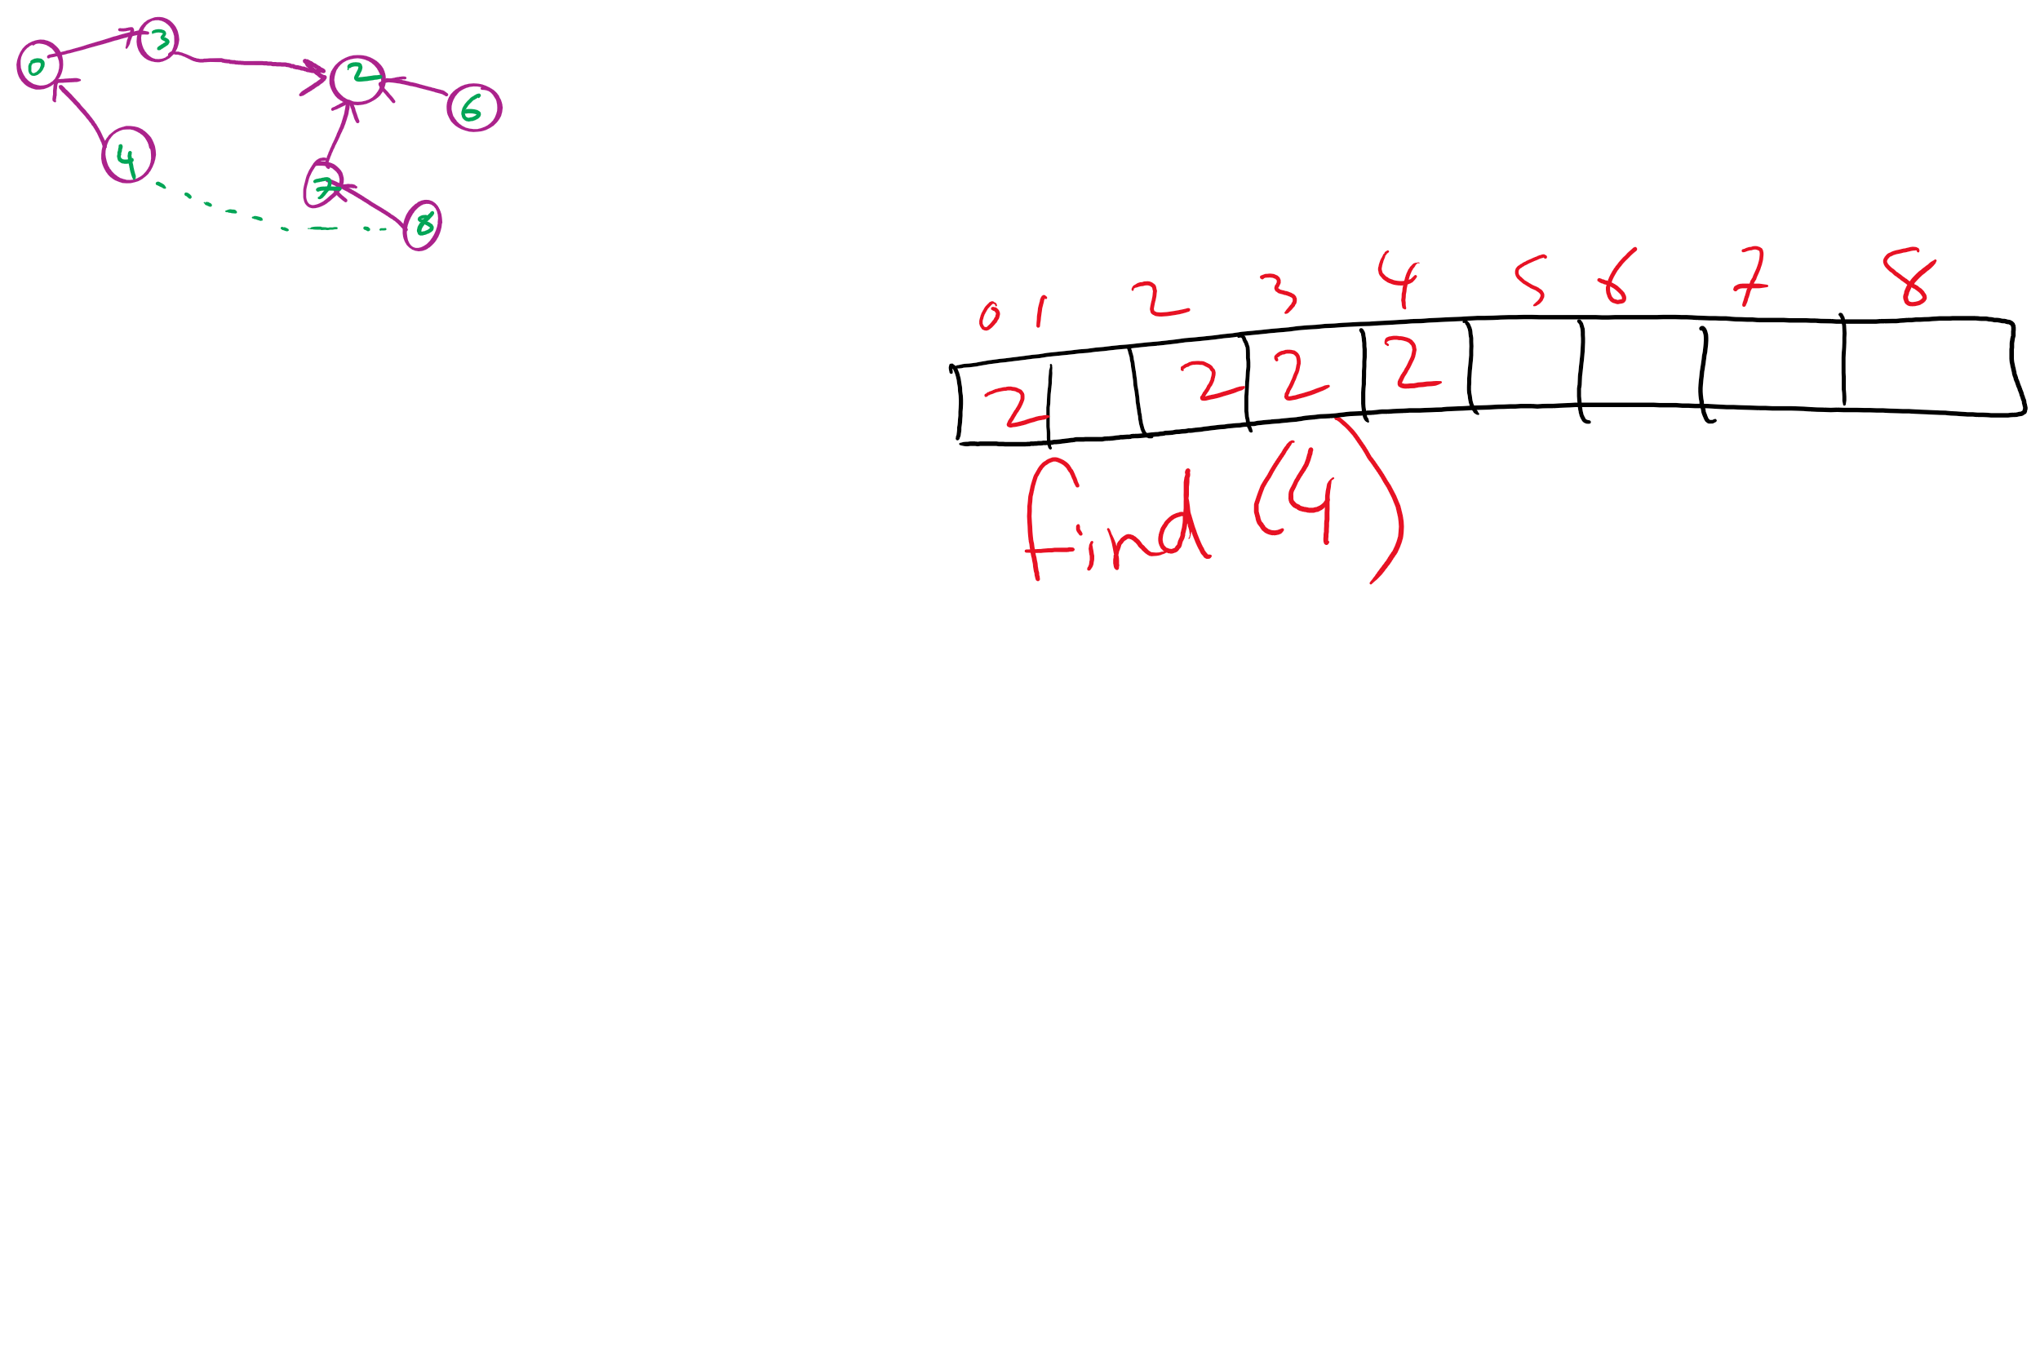
Path Compression Example

Slide 28
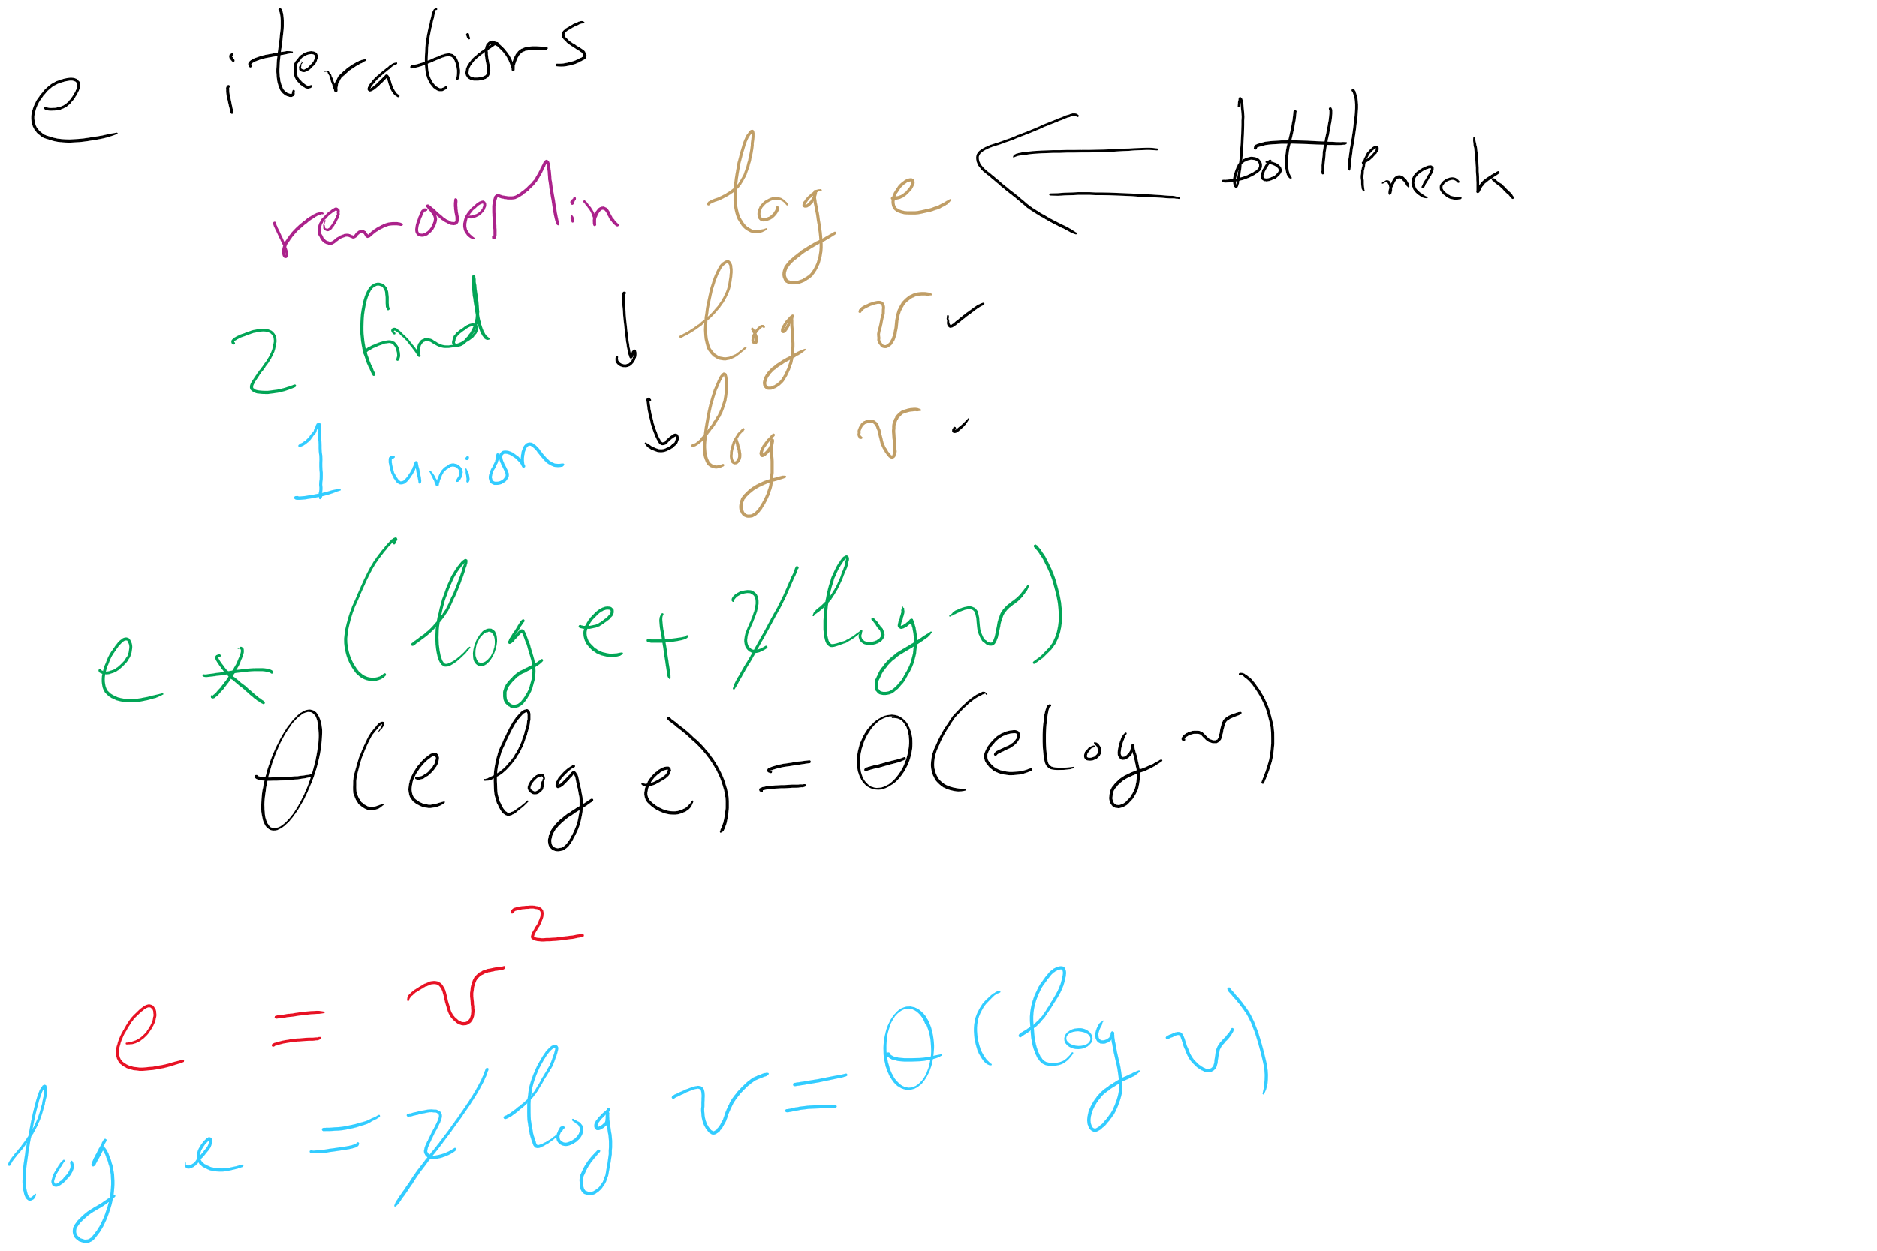
Kruskal’s algorithm, once again
What is the runtime of Kruskal’s algorithm??

Slide 29
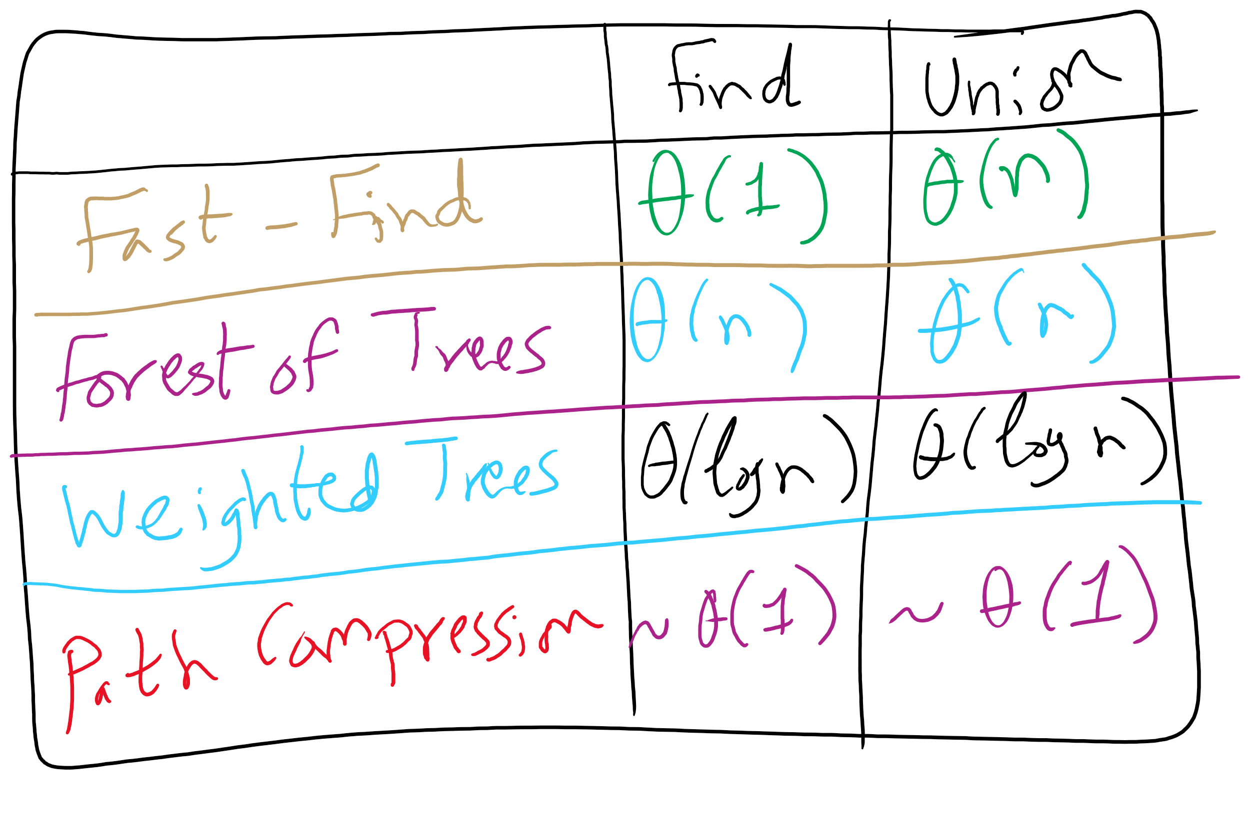
Union-Find Implementations

Slide 30
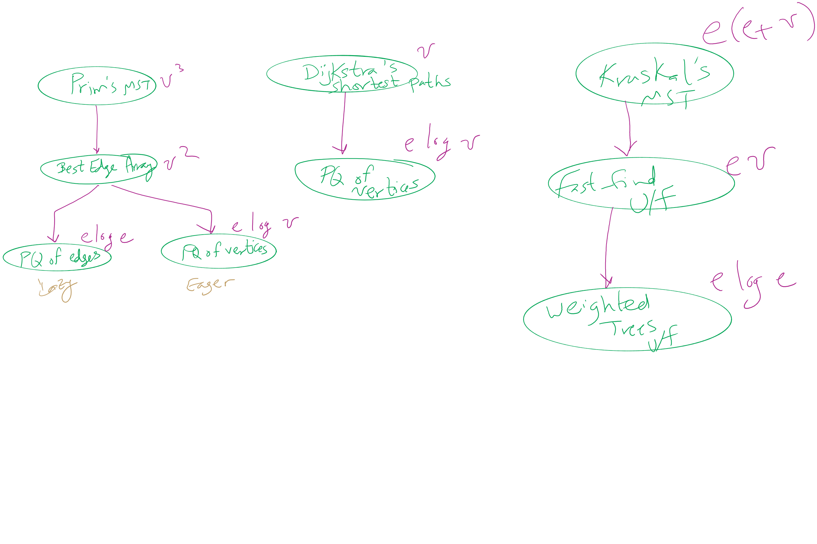
Algorithm Optimizations
2

Slide 31
Defining network flow
Consider a directed, weighted graph G(V, E)
Weights are applied to edges to state their capacity
c(u, w) is the capacity of edge (u, w)
if there is no edge from u to w, c(u, w) = 0
Consider two vertices, a source s and a sink t
Let’s determine the maximum flow that can run from s to t in the graph G

Slide 32
Flow
Let the f(u, w) be the amount of flow being carried along the edge (u, w)
Some rules on the flow running through an edge:
∀(u, w) ∈ E f(u, w) <= c(u, w)
∀u ∈ (V - {s,t}) (Σ_{w∈V} f(w, u) - Σ_{w∈V} f(u, w)) = 0

Slide 33
Ford Fulkerson
Let all edges in G have an allocated flow of 0
While there is path p from s to t in G s.t. all edges in p have some residual capacity (i.e., ∀(u, w) ∈ p f(u, w) < c(u, w)):
(Such a path is called an augmenting path)
Compute the residual capacity of each edge in p
Residual capacity of edge (u, w) is c(u, w) - f(u, w)
Find the edge with the minimum residual capacity in p
We’ll call this residual capacity new_flow
Increment the flow on all edges in p by new_flow

Slide 34
Ford Fulkerson example
5
/5
s
10
A
B
t
/10
5
/10
5
/10
5
10
/5
5

Slide 35
Please submit your reflections by using the CourseMIRROR App
If you are having a problem with CourseMIRROR, please send an email to coursemirror.development@gmail.com
Notes:
All right!
Upcoming Due Dates at A Glance

